Slide 1
Investigating Thai seller’s Facebook posts
Authors: tran tien an, do minh huy
Student ids: s3699000, s3751305

Slide 2
Outline
Project
Data preparation
Exploring
Modelling
Conclusion & Recommendation

Slide 3
Project
The data set: conducted by collection Facebook reseller’s post
The problem of this data set:
Ungrouped posts and status
The main goal of this project:
Group the posts which have the similarity
Analyze those posts groups
Provide some recommendations for the resellers

Slide 4
Preparation
Loading the data set:
Pandas function
Checking the data types and missing values:
Build-in functions
Sanity check function:
Check if the data make any senses

Slide 5
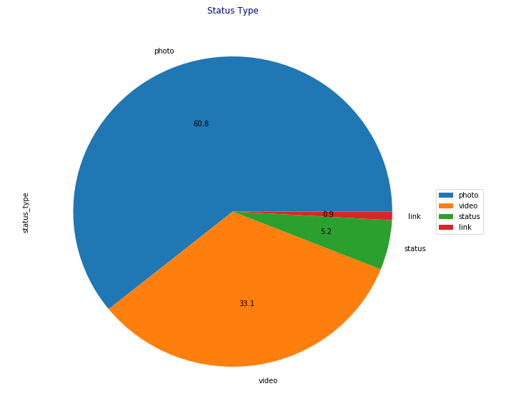
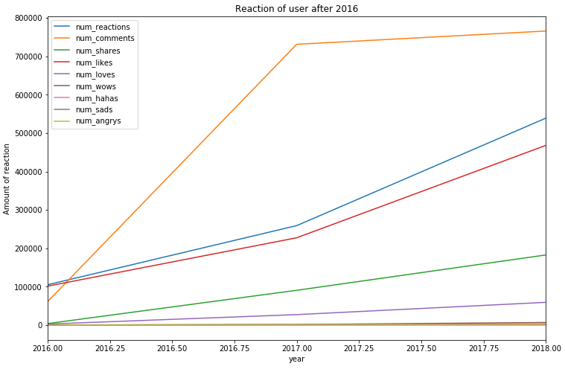
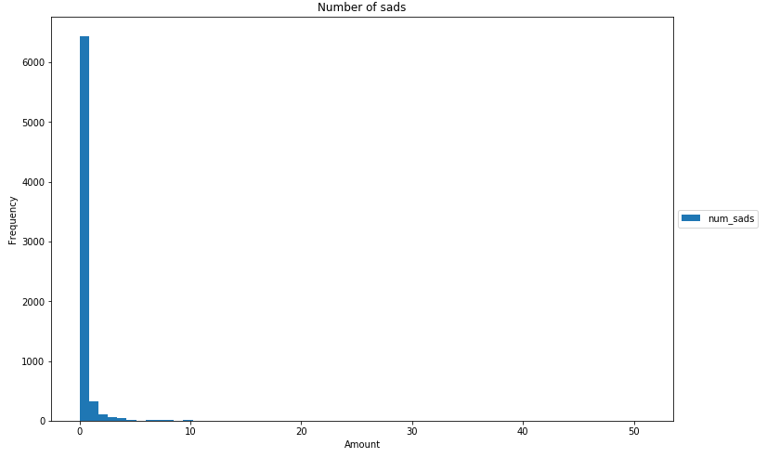
exploring
We conducted the histograms of number of reaction and other reaction types:
Most used types: Like and Love
Minor types: Sad, Angry
We exanimated the pie chart of status types:
Most used: Photo, video
Less used: Link, simple quote status
2 line graphs show the number of reaction on different times:
Before 2016
After 2016

Slide 6
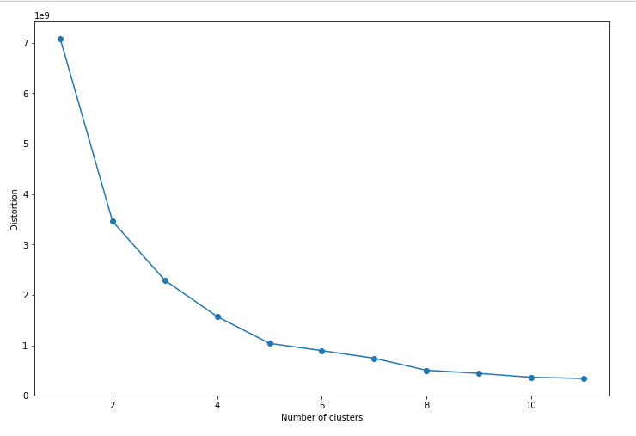
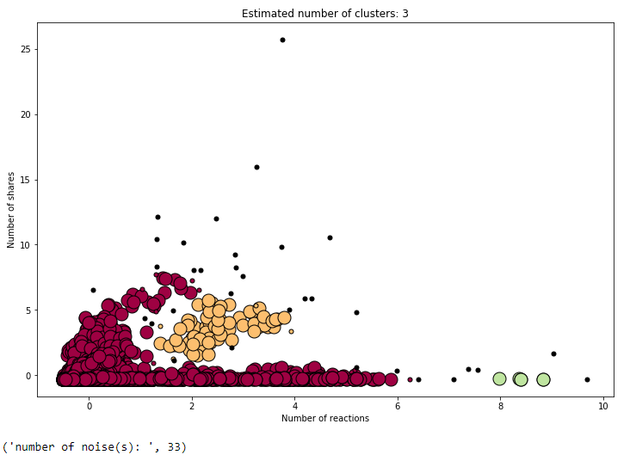
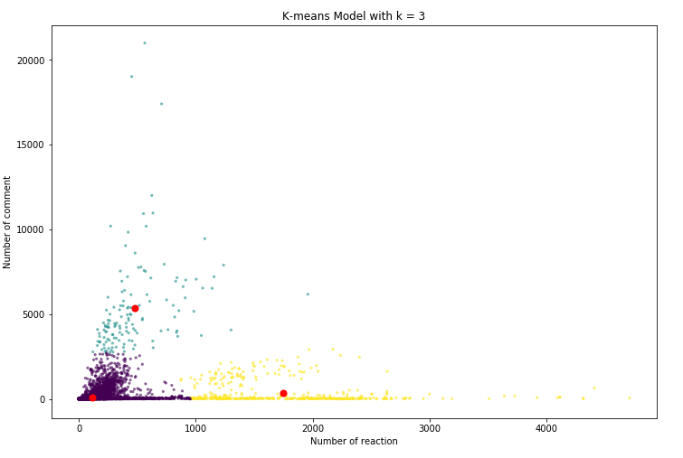
Modeling
Applying elbow method to find k value
k = 2 and k = 3 are possible
Use the DB Scan to decide the number of cluster
K-means results:
We have 3 main clusters
Outliners

Slide 7

Conclusion & Recommendation
The relationship between seller’s posts and customers has been investigated.
The main goal of the project has been achieved.
The sellers are recommended to have their posts in photo or video type.

